Slide 1

Abstract data Structure
Year 13

Slide 2

Objectives
Students should be able to
State what are abstract Data Structure
Describe how a stack DST works
Write a python code to implement a Stack DST
State example of stack ADT in real life
Describe how a Queue DST works
Write a python code to implement a Queue DST
State example of Queue ADT in real life

Slide 3
What is a data Structure?
Data Structure is a way of collecting and organizing data in the computer in such a way that different operations such as searching and retrieving, on these data can be done in an effective manner.
Anything that can store data in the computer can be called a data structure.
They are containers used by the computer to store data

Slide 4
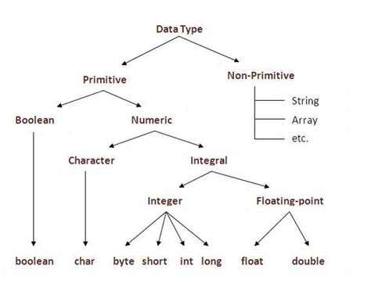
Types of Data Structure
Primitive Data Structure
Primitive Data Structure is also called Built-in Data structures because they are built into a programming language.
They are atomic and cannot be divided further
They are the basic data types that are available in most of the programming languages.
These are divided in two types
Primitive
Non-primitive

Slide 5
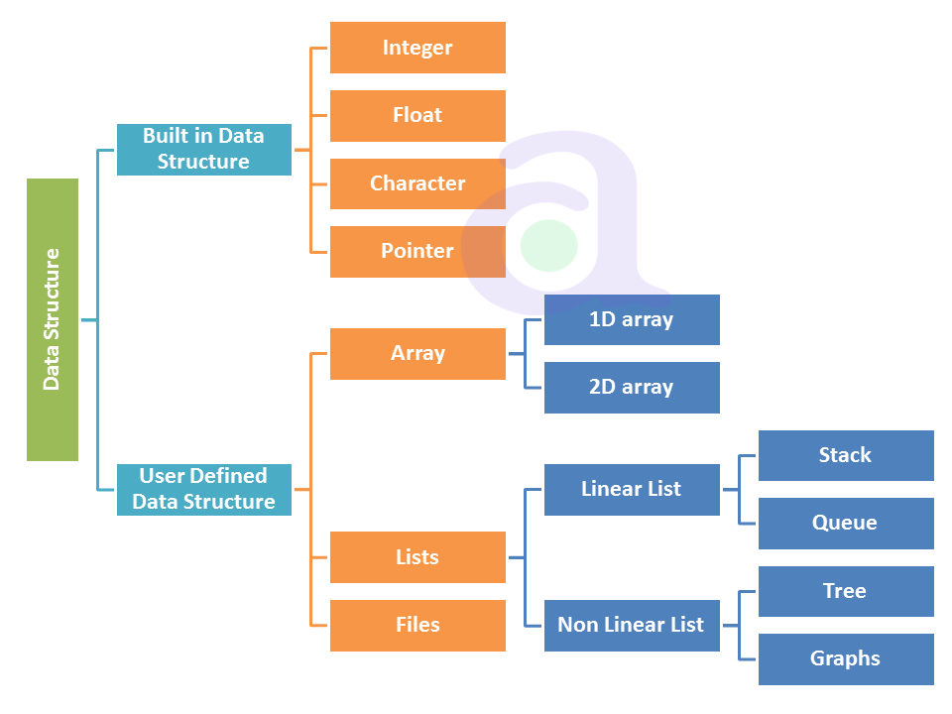
Non-Primitive Data Structures
Also called User Defined Data Structure
They are complex Structures, that are used to store large groups of connected data.
They are not atomic and cannot be formed without using primitive data structure

Slide 6
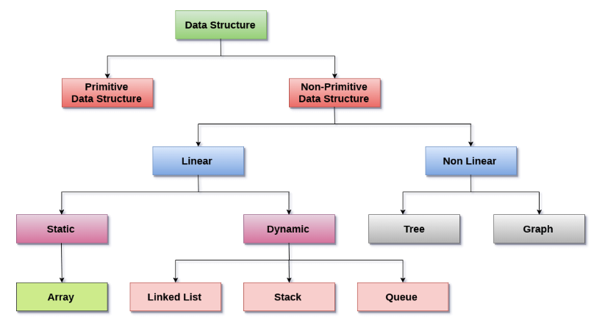

Slide 7
List data structure
Abstract data type in which the elements are stored in an ordered manner for easier and efficient retrieval of the elements.
List data structure allows repetition that means a single piece of data can occur more than once in a list.
In the case of multiple entries of the same data, each entry of that repeating data is considered as a distinct item or entry.
It is very much similar to the array but the major difference between the array and the list data structure is that array stores only homogenous data in them whereas the list (in some programming languages) can store heterogeneous data items in its object.

Slide 8
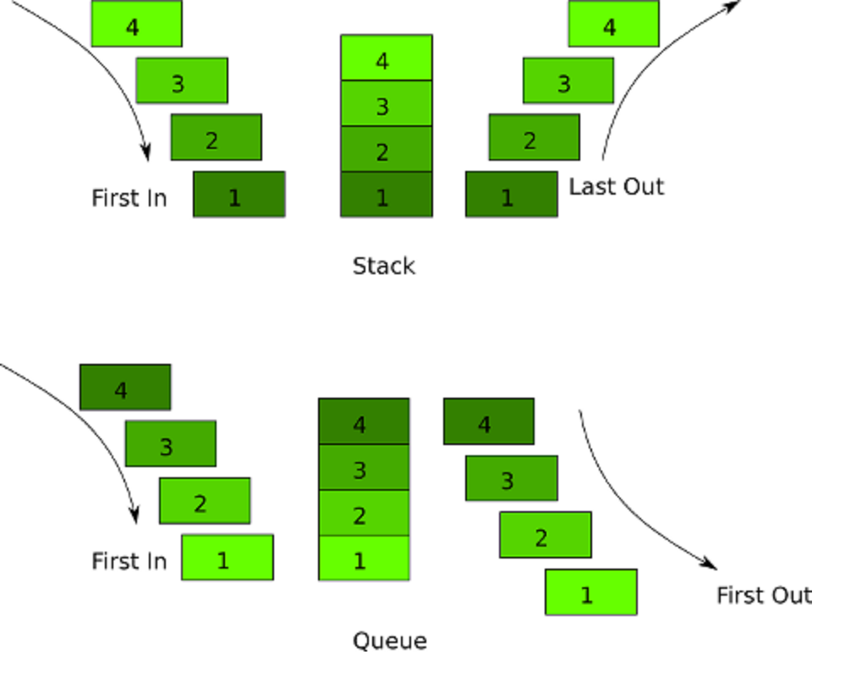
STACK
A stack is a dynamic linear data structure in which all the insertion and deletion of data/ values are done at one end only, rather than in the middle.
It uses the last-in-first-out principle (LIFO) to define data structure - this structure limits data in the way that it can only be added to or removed from the top

Slide 9
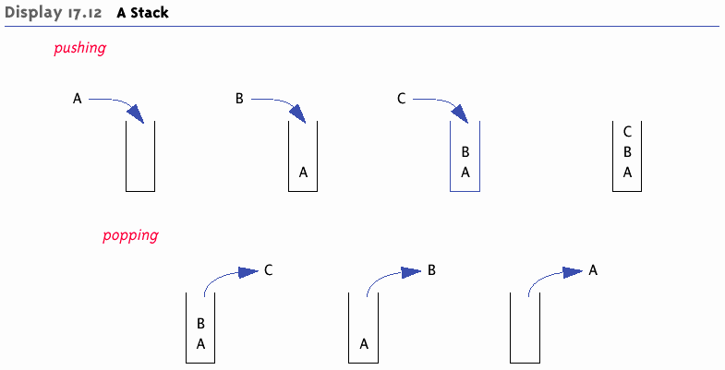
STACK
The delete operation is known as POP, in relation to the physical idea of popping something from a stack - the LIFO structure also means we can only remove the item that was most recently added.
In order to add items to a stack, the PUSH operation can be used, which refers to the physical idea of pushing an item onto the top of a stack.
As well as the push and pop operations we also have access to:
peek — used to return the item at the top of the stack
isempty — used to check whether the stack contains items

Slide 10
Situation Where Stack are used
There are many situations where a stack can be useful.
Undo/backtracking: Stack is also used to undo in text-editor.
Forward and backward feature in web browsers
Expression conversion: An expression is represented in the prefix, postfix, or infix notation. The stack is used to convert the form of one expression to another form.
Syntax parsing: Many compilers use the stack to parsing the syntax expressions.
Memory management: It is also used in memory management.
Variable tracking: Stack is also used to track local variables in runtime.
Parenthesis checking: Used to check whether parenthesis is correctly open and closed or not.
String reverse: Used to reverse the string. In the string, we push the characters into the stack one by one and then pop the characters from the stack one by one.

Slide 11
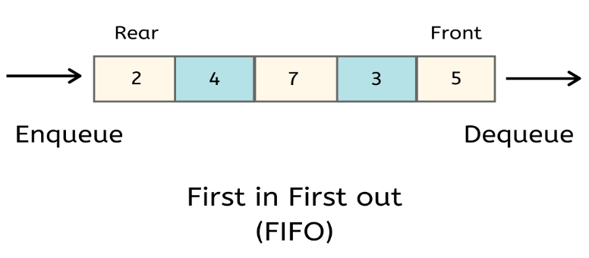
Queue
It is implemented on a First-In-First-Out (FIFO) principle, meaning that the items are removed from the list in exactly the same order in which they were added to it.
For example, it simulates the physical approach of a queuing systems used whilst waiting in line at your favourite food store - the first in line will be the first to leave, with new people being, added to the back of the queue.

Slide 12
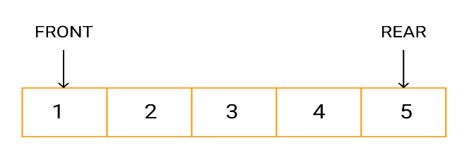
Queue
It maintains two pointers
A front of queue pointer
An 'end of queue' pointer
Most times queues are used whenever there are a number of items waiting for a resource to become available.

Slide 13
Types of Queues
Circular queue/ 'circular buffer. This is a particular kind of queue where new items are added to the rear of the queue as items are read off the front of the queue, So there is constant stream of data flowing into and out of the queue. This kind of queue reduces wastage of space in case of array implementation
Linear Queue works its way through the allotted memory without reusing the memory.
Priority Queue: An element is given a value to indicate its priority. Items with the highest is process first. An element with high priority is dequeued before an element with low priority. If two elements have the same priority, they are served according to their order in the queue

Slide 14
Application of Queues
Interrupts handling: A queue can be used to store a list of interrupts in the operating system, which would get processed in the order in which they were generated.
Time sharing OS. A queue can be found in a time-sharing computer system where many users share the system simultaneously and share the space of the memory.
Computer Network (LAN). Messages send are kept in a buffer until the receiving computer is ready for it. Messages also need to be sent to receiving computer in the same order in which they are created, i.e. FIFO order.
Used in printing. The jobs are printed in the order they are received. (FIFO)

Slide 15

ACTIVITY

Slide 16
Thank You

Slide 17
Customize this Template
Template Editing Instructions and Feedback

